Slide 1
Difference Between ES5 and ES6
Presented By
N. Harsha Vardhan.

Slide 2
What is ECMAScript?
ECMAScript is a trademarked scripting language specification that is defined by ECMA International. It was created to standardize JavaScript. The ES scripting language has many implementations, and the popular one is JavaScript. Generally, ECMAScript is used for client-side scripting of the World Wide Web.

Slide 3
What are ES5 and ES6?
ES5 is an abbreviation of ECMAScript 5 and also known as ECMAScript 2009. The sixth edition of the ECMAScript standard is ES6 or ECMAScript 6. It is also known as ECMAScript 2015. ES6 is a major enhancement in the JavaScript language that allows us to write programs for complex applications.
Although ES5 and ES6 have some similarities in their nature, there are also so many differences between them.

Slide 4
Difference between ES5 and ES6?
ES5
ES6
ES5 is the fifth edition of the ECMAScript (a trademarked scripting language specification defined by ECMA International)
It was introduced in 2009.
ES5 supports primitive data types that are string, number, boolean, null, and undefined.
In ES5, we could only define the variables by using the var keyword.
ES6 is the sixth edition of the ECMAScript (a trademarked scripting language specification defined by ECMA International).
It was introduced in 2015.
In ES6, there are some additions to JavaScript data types. It introduced a new primitive data type 'symbol' for supporting unique values.
In ES6, there are two new ways to define variables that are let and const.

Slide 5
ES5
ES6
As ES5 is prior to ES6, there is a non-presence of some features, so it has a lower performance than ES6.
A wide range of communities supports it.
ES5 is time-consuming than ES6. When it comes to Object manipulation.
In ES5, both function and return keywords are used to define a function.
In ES5, there is a use of for loop to iterate over elements.
Because of new features and the shorthand storage implementation ES6 has a higher performance than ES5.
It also has a lot of community support, but it is lesser than ES5.
Due to destructuring and speed operators, object manipulation can be processed more smoothly in ES6.
An arrow function is a new feature introduced in ES6 by which we don't require the function keyword to define the function
ES6 introduced the concept of for...of loop to perform an iteration over the values of the iterable objects.

Slide 6
Transpilation
As we have the different versions of javascipts which we use while developing our applications. But at the end the user is the one who would use our application.
If the user is using a browser which is not updated then it would not support the latest javascipt version features.
To avoid this discrepancies we have the Transpilation. This is a process where the client machine’s browser version is taken into account and performs necessary changes to make all the features work similarly as it would on a higher version machine
Known transpilers are Babel and Traceur.

Slide 7
ES6 specific features
Arrows - Arrows are a function shorthand using the => syntax.
Classes - in ES6 the classes declaration was significantly. Classes support prototype-based inheritance, super calls, instance and static methods and constructors.
Template Strings- these are the string declarations in which we can directly insert the variable values. These are declared using the back tic(`) symbol. And the variable injection is done using the dollar ${var} type declaration.
Destructuring - Destructuring allows binding using pattern matching, with support for matching arrays and objects. Destructuring is fail-soft, similar to standard object lookup foo["bar"], producing undefined values when not found.

Slide 8
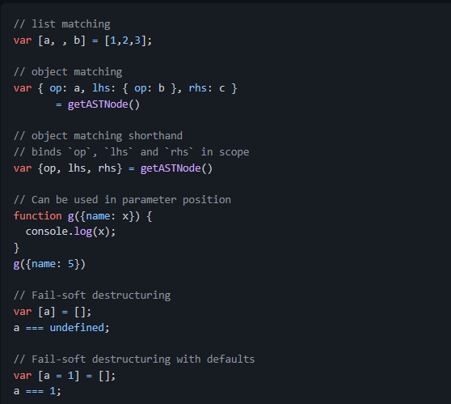
Destructuring Examples

Slide 9
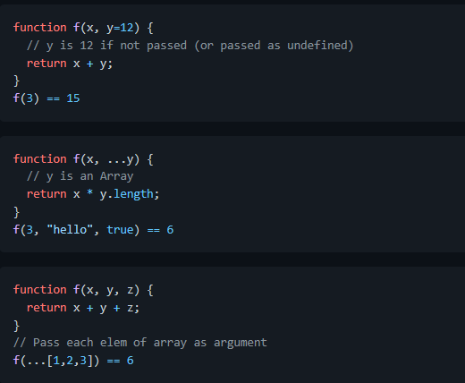
Default + Rest + Spread

Slide 10
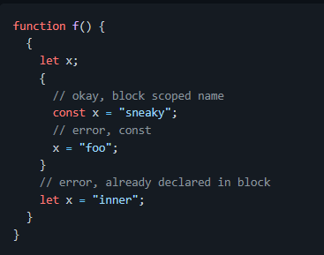
Let and const
Block-scoped binding constructs. let is the new var. const is single-assignment. Static restrictions prevent use before assignment.

Slide 11
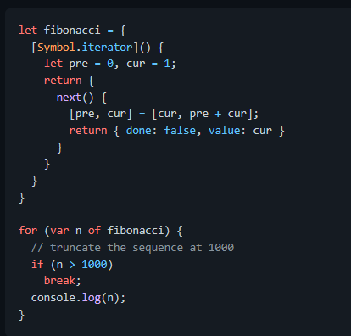
Iterators + For..Of
Iterator objects enable custom iteration like CLR IEnumerable or Java Iterable. Generalize for..in to custom iterator-based iteration with for..of. Don’t require realizing an array, enabling lazy design patterns like LINQ.

